Slide 1

Pet Adoption
By Daniel Pivonka, Brianne Bindas, and Scott Mello

Slide 2
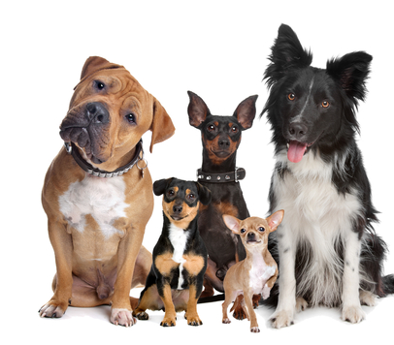
Project Goal
Connect users to a database of over 300,000 pets up for adoption
Use our search feature to find your perfect pet
View pet profiles and pictures
Add pets to your favorites so you don’t lose track of the pet you want
Help more pets get adopted!

Slide 3
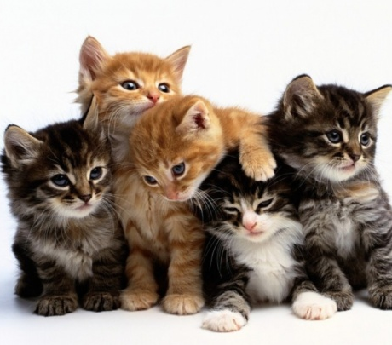
Project Features
Pet Search Functionality
Display list of pets that match search
View pet profile and pictures
Favorites database to store pets you’re thinking of adopting

Slide 4
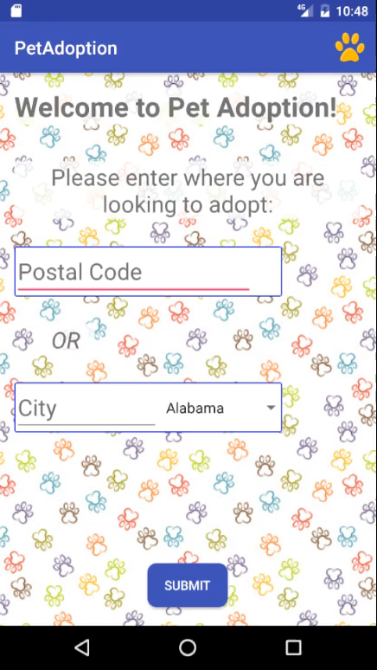
Video Demo

Slide 5
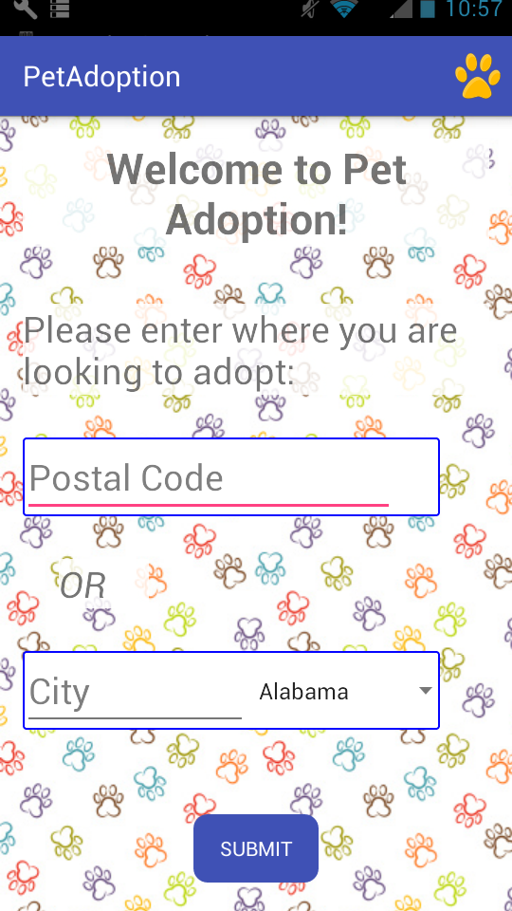
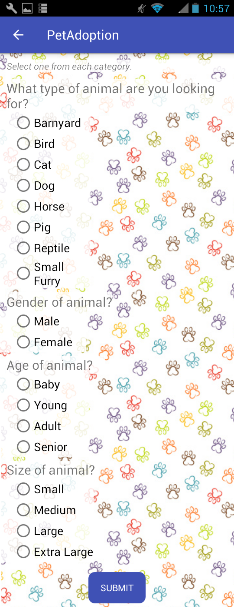
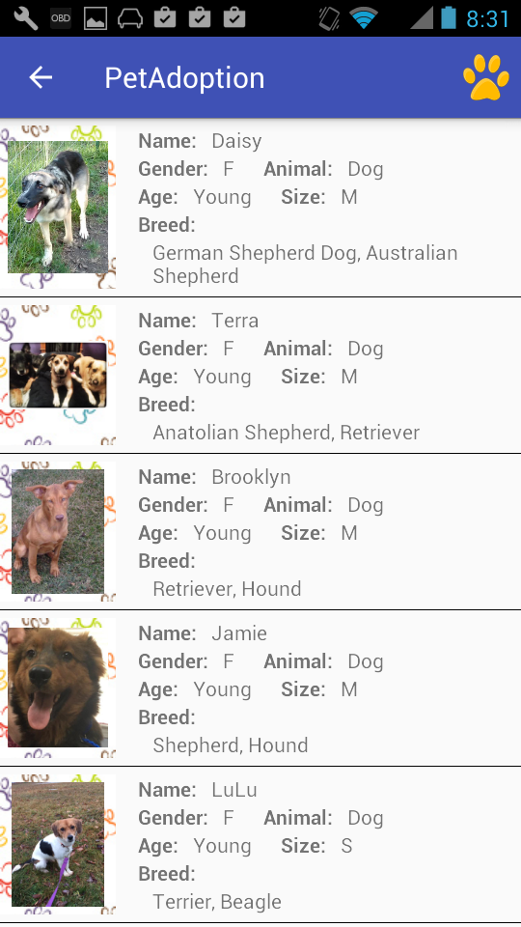
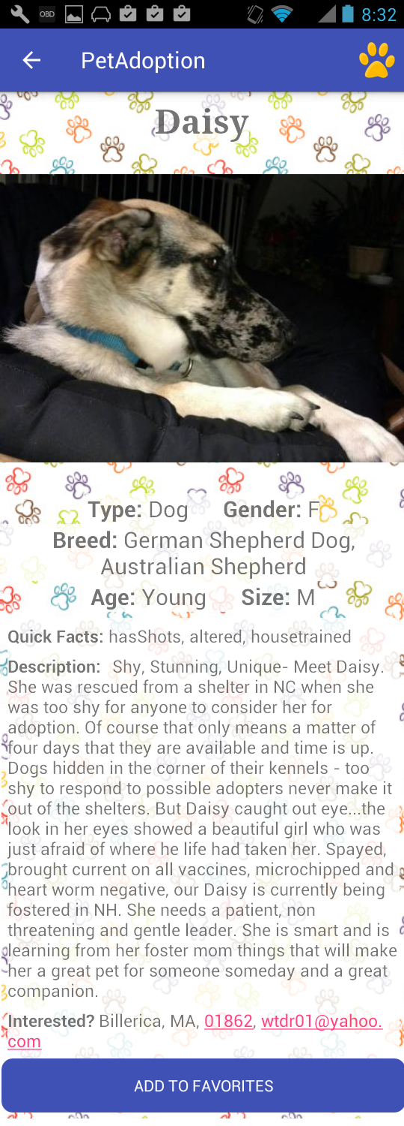
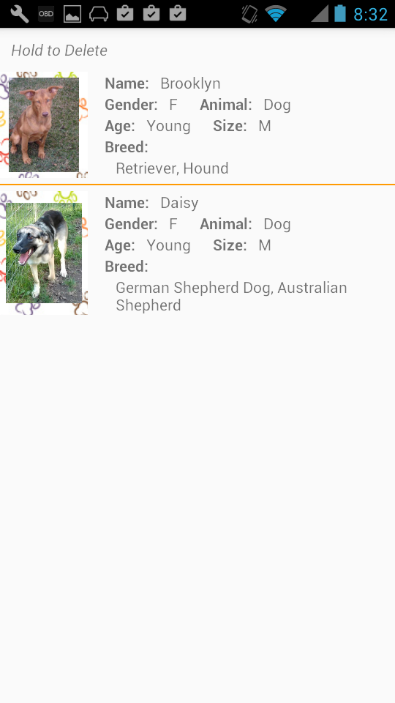
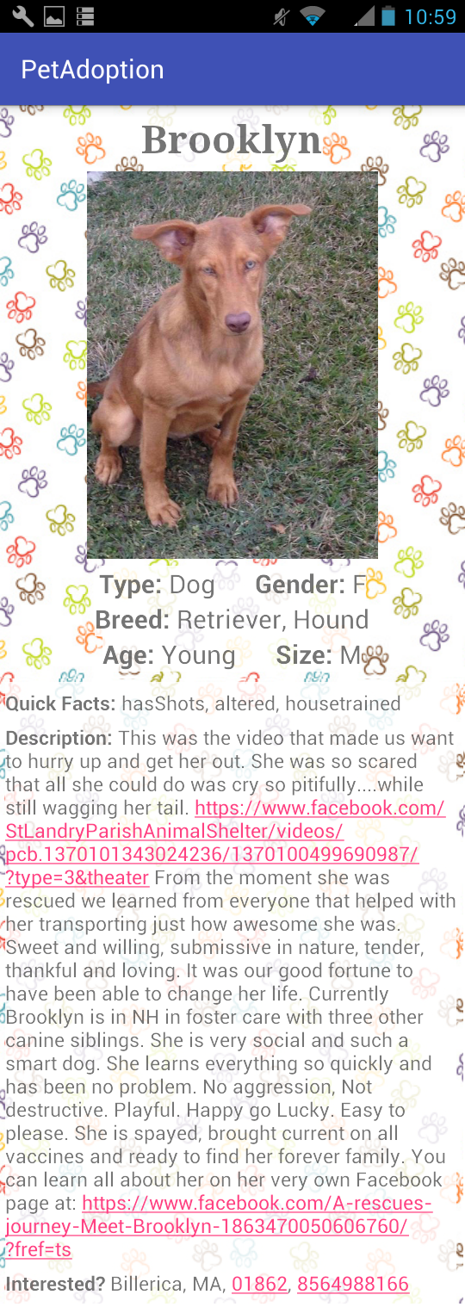
Project Design

Slide 6
Brianne’s Work
Designed most of the UI
Retrieved location and type of pets user requests
Helped Code:
PetTypeActivity
PetViewActivity
All Layout files

Slide 7
Dan’s Work
Created Utilities to Sent requests to API, and Parsed JSON
Created Pets Class
Created PetAdapter
Helped Code:
MainActivity
PetTypeActivity
PetListActivity
PetViewActivity

Slide 8
Scott’s Work
Created Favorites Database
Displayed favorite pet profiles
Helped With UI
Help with Activities
Helped Code:
FavoritesActivity
FavoritesViewActivity
PetCursorAdapter
FavoritesContentProvider
FavoritesTable
PetAdoptionDatabaseHelper

Slide 9
File Structure
MainActivity – Gets location from user – Code by Daniel, Layout by Brianne
PetTypeActivity – Gets search options from user – Code by Daniel and Brianne, Layout by Brianne
PetListActivity – Show list of pet returned from search, starts AsyncTask – Code by Daniel, Layout by Brianne
PetViewActivity –Show profile and pictures of selected pet – Code By Daniel and Brianne, Layout by Brianne
FavoritesActivity – Show list of pets added to favorites – Code by Scott, Layout by Scott and Brianne
FavoritesViewActivity- Shows profile and picture of pet from favorites list – Code by Scott, Layout by Brianne
Pets – Class to hold a single pets info – Code by Daniel
PetAdapter – Adapter used to display pet list – Code by Daniel
FavoritesTable – Database to hold favorite pets info – Code by Scott
FavoritesContentProvider - Manages access to the Favorites Database - Code by Scott
PetAdoptionDatabaseHelper - A helper class to manage database creation/version - Code by Scott
PetCursorAdapter - Used to bind database fields to views - Code by Scott
Utils – Network utilities to retrieve pets from API – Code by Daniel

